Slide 1
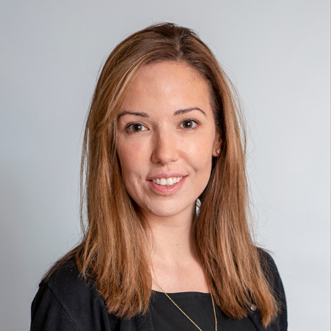
NIDDK P30 Center for Molecular Studies in Digestive and Liver Diseases
Research Seminar
12:00 PM – 1:00 PM
October 14, 2021
https://pennmedicine.zoom.us/j/92493022344?
pwd=b1NYU3VVaTFmUS9YdllDaEFGNmdSQT09
Tracey Simon, MD
Assistant Professor
Division of Gastroenterology
Harvard Medical School
“Novel HCC Prevention Strategies”
Meeting starts promptly at 12:00 pm. Please be on time.
Everyone inside and outside of the division is welcome to attend.
For more information, please visit our website. http://www.med.upenn.edu/gastro/

